Slide 1


Slide 2
Modeling the spread of the common cold in an elementary school with an SEIR model
Notes:
Cries en revanche

Slide 3
Table of Contents
Introduction
SEIR model
Simulation under base case (no vaccination)
Simulation for vaccination strategies
Results and conclusions

Slide 4
Team Members
Christos | KARATZIAS
Sri Prasanna | MADDILA SIVA
Lucca | REINEHR SILVA
Wai Mun | TSOI
Quentin | GRANIER

Slide 5
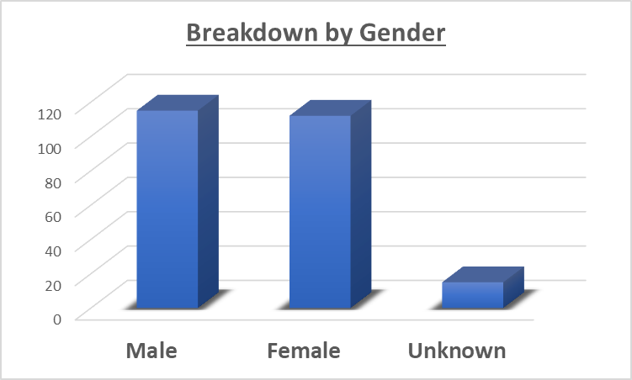
Statistics of population under study

Slide 6
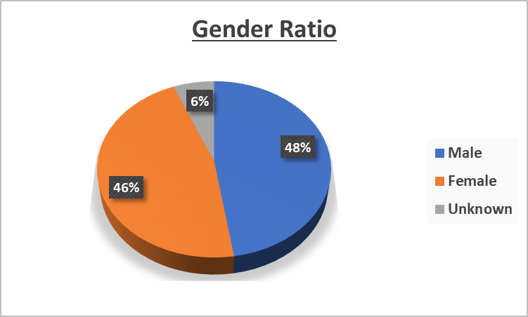
Statistics of population under study

Slide 7
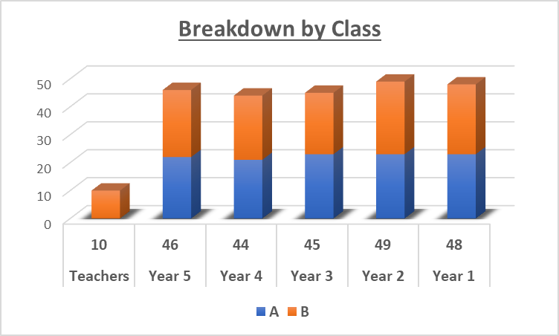
Statistics of population under study

Slide 8
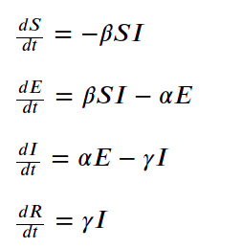
Once upon a time, during winter time…The Cold appeared
Why SEIR and not SIR?
Susceptible people become Infectious people upon contracting the cold immediately (in the SIR model);
Most viruses have an incubation period, where the newly-infected people are not yet contagious. Hence,a new compartment, Exposed, is added;
Afterwhich, people can also Recover from the virus or be Removed due to the vaccination.
We introduced the Exposed people in the famous propagation equations as shown on the left. It takes into account the 3 following parameters:
1/𝛼 : latent period of virus (incubation period)
1/𝛾 : mean infectious period
𝛽 : contact rate per individual
S+E+I+R = N
Evolution equations

Slide 9
More elaborate definitions
S: The number of susceptible individuals.When an susceptible and an infectious individual come into "infectious contact", the susceptible individual contracts the disease and transitions to the exposed compartment.
E: The number of exposed individuals. There is a significant latency period during which individuals have been infected but are not yet infectious themselves.
I: The number of infectious individuals. These are individuals who have been infected and are capable of infecting susceptible individuals.
R: The number of removed (and immune) or deceased individuals. These are individuals who have been infected and have either recovered from the disease and entered the removed compartment, or died. It is assumed that the number of deaths is negligible with respect to the total population. This compartment may also be called "recovered" or "resistant".

Slide 10
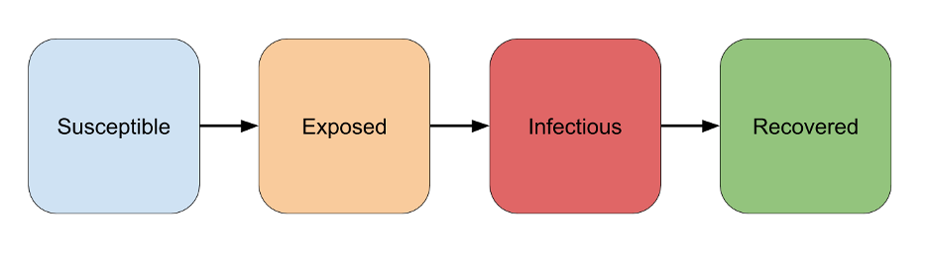
SEIR model
α β γ
Exposed

Slide 11
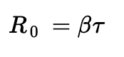
Implementing the model with the Cold data
After some research, we found those sets of data:
𝛼 = ½
𝛽 = 0.8
𝛾 = 1/14
The average incubation period of the common cold is 2 days (from the CDC) and the the worst-case (or longest) infectious period is 2 weeks or 14 days.
Using the formula for basic reproductive number, ℜ_{0, cold} = 3,
where 𝜏 is mean infectious period.
S+E+I+R = N

Slide 12
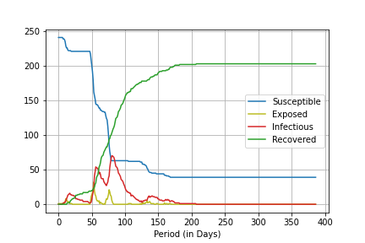
Evolution of epidemic (without vaccination)
α = 1/2
β = 0.8
γ = 1/14
Epidemic ends in 207 days

Slide 13
Vaccination strategies

Slide 14
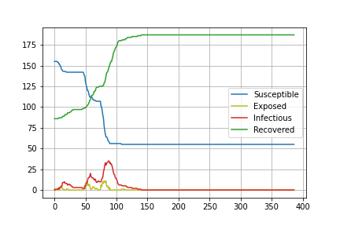
Evolution of epidemic (random vaccination at time t0)
α = 1/2
β = 0.8
γ = 1/14
Random vaccination
- 40% of the population
- on day 0
Epidemic ends in 140 days

Slide 15
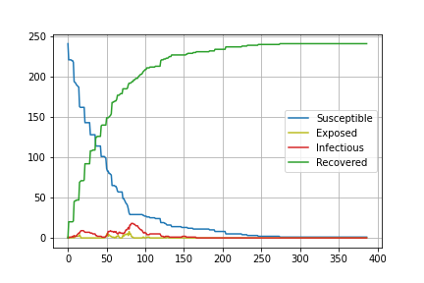
Evolution of epidemic (periodic random vaccination)
α = 1/2
β = 0.8
γ = 1/14
Periodic vaccination
- 10% of the population
- every 7 days
Epidemic ends in 166 days

Slide 16
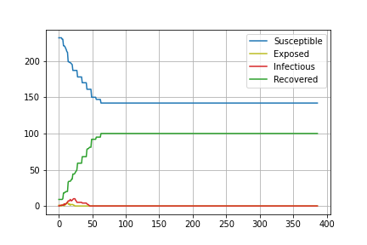
Evolution of epidemic (periodic vaccination w/ limited number of doses)
α = 1/2
β = 0.8
γ = 1/14
Periodic vaccination with
limited number of doses
- 100 doses
- 10 doses a day
- every 7 days
Epidemic ends in 46 days

Slide 17
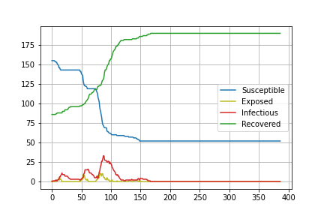
Evolution of epidemic (uniform class-based vaccination)
α = 1/2
β = 0.8
γ = 1/14
Vaccination by class
- 40% of every class
- on day 0
Epidemic ends in 167 days

Slide 18
Overview
No vaccination | Random | Periodic random | Constant doses | Uniform by class
207 days | 140 days | 166 days | 46 days | 167 days
Days until end of epidemic

